Slide 1
Management & Organisational Behaviour 4
Module Code: ENGE08016

Slide 2
Self Management
&
Emotional Intelligence

Slide 3

Learning Objective
Define Self Management
Importance of Self Management
Key Characteristics of Self Management
Benefits of Self Management
Understanding Emotional Intelligence
The Intersection of Self-Management and Emotional Intelligence
Emotional Intelligence & Self-Management and in the Workplace.
Image Source: Medium.com

Slide 4
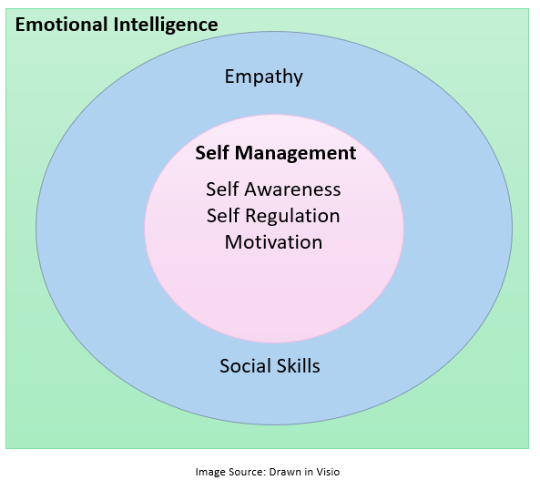
Intersection of Self-Management and Emotional Intelligence
The intersection of self-management and emotional intelligence involves using self-awareness as a foundation to effectively regulate and control one's emotions, thoughts, and behaviours.
This ability leads to adaptability, conflict resolution, resilience, and overall enhanced personal and professional effectiveness.

Slide 5
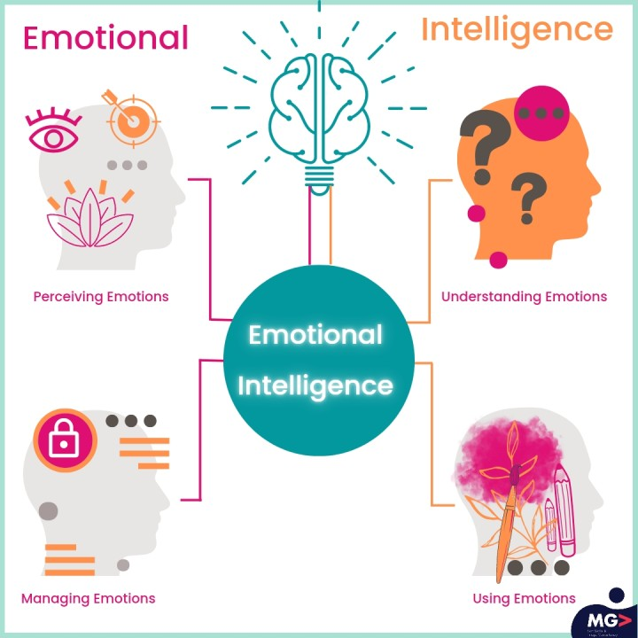
What is Self Management?
Self-management refers to the ability of an individual to regulate and control their own thoughts, emotions, behaviours, and actions in order to achieve personal and professional goals. It involves being aware of one's strengths and weaknesses, setting and prioritizing goals, making decisions, and effectively managing time and resources to achieve those goals.
In the workplace, self-management is a valuable skill that employers often look for in employees. It contributes to personal productivity, team effectiveness, and overall organizational success. In personal life, self-management leads to a more balanced and fulfilling life by allowing individuals to organize their time, energy, and efforts in a way that aligns with their values and aspirations.
Image Source: LinkedIn

Slide 6

What is Self Management?
Self-management is a comprehensive skill set that involves controlling and directing one's actions, thoughts, and emotions to achieve personal and professional goals.
Three key characteristics of self-management are
Self-awareness
Self-regulation
Motivation
Image Source: Google Images

Slide 7
What is Self Management?
Self-awareness: Understanding one's emotions, strengths, weaknesses, values, and goals. Self-awareness is the foundation of effective self-management.
Emotional Regulation: The ability to recognize, understand, and manage one's own emotions in various situations. This includes coping with stress, frustration, and maintaining a positive outlook even in challenging circumstances.
Time Management: Allocating time effectively to tasks and activities, prioritizing them based on importance and urgency. This involves setting achievable goals and deadlines.
Goal Setting and Planning: Establishing clear and achievable short-term and long-term objectives and creating a plan to reach those objectives. Breaking down larger goals into smaller, manageable tasks.

Slide 8
What is Self Management?
Decision Making: Making informed and thoughtful decisions by evaluating options, considering consequences, and aligning choices with personal values and objectives.
Adaptability and Flexibility: Being open to change and able to adapt to new circumstances and unexpected events while maintaining focus on goals and priorities.
Stress Management: Implementing techniques and strategies to cope with stress and pressure effectively, ensuring well-being and maintaining productivity.
Accountability and Responsibility: Taking ownership of one's actions, accepting the consequences, and being accountable for fulfilling commitments and responsibilities.

Slide 9
Importance of Self-Management
Self-awareness and self-regulation are fundamental characteristics of self-management and play crucial roles in an individual's ability to effectively control and direct their actions, emotions, and behaviours towards achieving personal and professional goals. Here's why they are essential:
Facilitating Goal Setting and Alignment:
Self-awareness: Understanding one's values, strengths, weaknesses, and aspirations helps in setting meaningful and realistic goals that align with personal values and long-term objectives.
Self-regulation: It ensures that the goals set are pursued in a disciplined and organized manner, with the ability to resist impulsive actions or distractions that may derail progress.
Enhancing Decision Making:
Self-awareness: Knowing one's own decision-making tendencies, biases, and preferences allows for more informed and intentional decision-making.
Self-regulation: It helps in exercising self-control during decision-making, ensuring decisions are based on careful thought rather than impulsivity or emotional reactions.

Slide 10
Importance of Self-Management
Improving Emotional Intelligence and Handling Stress:
Self-awareness: Recognizing and understanding one's own emotions and triggers enables better management of emotional responses, reducing stress and improving emotional intelligence.
Self-regulation: It involves using this emotional awareness to regulate and control emotions, enabling a more balanced and composed approach to challenges and stressors.
Building Effective Relationships:
Self-awareness: Understanding one's communication style, strengths, and areas for improvement aids in building and maintaining positive relationships with others.
Self-regulation: It helps in managing one's reactions and behaviours in interpersonal interactions, promoting better communication and collaboration.
Boosting Productivity and Time Management:
Self-awareness: Knowing one's peak performance times and productivity patterns allows for better time management and allocation of tasks.
Self-regulation: It ensures adherence to schedules and deadlines, optimizing productivity and achieving more in the available time.

Slide 11
Importance of Self-Management
Promoting Adaptability and Learning:
Self-awareness: Recognizing areas for growth and improvement supports ongoing learning and development.
Self-regulation: It assists in adapting to change and adjusting behaviours or approaches to align with new circumstances or challenges.
Fostering Resilience and Perseverance:
Self-awareness: Understanding one's resilience levels and coping mechanisms enables proactive preparation for and management of adversity.
Self-regulation: It helps in staying focused, persistent, and resilient in the face of obstacles, driving progress towards set goals even in challenging situations.

Slide 12

Self Awareness
Self-awareness is the foundation of self-management. It involves understanding oneself, including one's emotions, thoughts, behaviours, strengths, weaknesses, values, and motives. Here's what it entails:
Emotional Awareness: Recognizing and understanding one's own emotions, their triggers, and how they impact actions and decisions.
Self-Perception: Having a clear understanding of one's self, self-worth, and self-confidence.
Understanding Strengths and Weaknesses: Identifying personal strengths to capitalize on them and acknowledging weaknesses to work on self-improvement.
Values and Beliefs: Being aware of one's values, beliefs, and principles that guide decisions and actions.
Goal Awareness: Understanding personal goals and aligning them with broader life objectives.
Image Source: NBC News

Slide 13

Self Regulation
Self-regulation is the ability to manage and control one's impulses, emotions, and behaviours. It involves using self-awareness to maintain control and stay on track with goals. Key aspects include:
Emotional Control: Effectively managing and controlling emotional responses, especially in challenging or stressful situations.
Impulse Control: Exercising restraint to avoid impulsive actions and making decisions based on logic and long-term considerations.
Adaptability: Adjusting behaviours and responses to changing circumstances or unexpected events without losing focus on goals.
Time Management: Efficiently utilizing time, setting priorities, and organizing tasks to achieve goals within set timeframes.
Self-Discipline: Cultivating the ability to stick to plans, follow through on commitments, and maintain consistency in efforts.
Image Source: LinkedIn

Slide 14

Motivation
Motivation is the driving force that initiates, sustains, and directs behaviour towards achieving a particular goal. It fuels determination, perseverance, and dedication. Key aspects of motivation include:
Intrinsic Motivation: Being driven by internal factors like personal satisfaction, passion, or the desire to achieve self-set goals.
Extrinsic Motivation: Being motivated by external factors such as rewards, recognition, or praise from others.
Goal Orientation: Setting clear and achievable goals and deriving motivation from the desire to reach these objectives.
Resilience: Bouncing back from setbacks and using challenges as a source of motivation to push forward and succeed.
Self-Efficacy: Believing in one's ability to accomplish tasks and achieve goals, even when faced with obstacles.
Image Source: LinkedIn

Slide 15

Benefits of Self Management
Self-management offers a multitude of benefits across various aspects of an individual's life, including personal, professional, and overall well-being. Here are some key benefits of practicing effective self-management:
Increased Productivity: Better time management and organization lead to increased productivity and efficiency in completing tasks and achieving goals.
Improved Focus and Concentration: By prioritizing tasks and managing distractions, individuals can maintain better focus and concentration on important activities.
Enhanced Goal Achievement: Self-management helps in setting clear goals, creating actionable plans, and staying committed, resulting in a higher likelihood of achieving personal and professional objectives.
Better Decision Making: Understanding oneself and exercising self-regulation improves decision-making by reducing impulsive actions and considering long-term consequences.
Image Source: Google Images

Slide 16

Benefits of Self Management
Heightened Adaptability: Self-management fosters adaptability by developing the ability to adjust to changes and handle unforeseen circumstances effectively.
Stress Reduction: Emotional regulation and effective stress management techniques, integral to self-management, can significantly reduce stress levels and promote overall well-being.
Enhanced Emotional Intelligence: Self-awareness and self-regulation, components of self-management, contribute to increased emotional intelligence, improving relationships and interactions with others.
Improved Relationships: Understanding oneself and regulating emotions positively impact relationships, leading to better communication, empathy, and conflict resolution.
Increased Self-Confidence and Self-Efficacy: Recognizing strengths, setting and achieving goals, and exercising discipline in self-management boost self-confidence and belief in one's capabilities.
Image Source: Google Images

Slide 17

Benefits of Self Management
Personal Growth and Development: Self-management encourages continuous self-reflection, learning, and growth, supporting personal development and fulfilment of potential.
Better Health and Well-being: Effective self-management habits, including healthy routines and stress reduction, contribute to improved physical and mental health.
Professional Advancement: By showcasing discipline, time management, and goal achievement in the workplace, self-management can lead to career growth and increased opportunities.
Enhanced Life Satisfaction: Achieving personal and professional goals, maintaining a work-life balance, and nurturing healthy relationships contribute to an overall sense of life satisfaction.
Empowerment and Autonomy: Self-management instils a sense of control and empowerment, allowing individuals to take charge of their lives and make choices that align with their values and goals.
Image Source: Google Images

Slide 18

Understanding Emotional Intelligence
Emotional intelligence (EI) is the ability to perceive, understand, manage, and effectively use emotions in oneself and others. It involves recognizing and interpreting emotional cues, empathizing with others' feelings, and utilizing emotional information to guide behaviour and decision-making. EI encompasses a range of skills that contribute to social awareness, relationship management, and self-awareness.
Emotional intelligence is a valuable asset that can significantly influence an individual's success and satisfaction in various aspects of life, making it a critical skill to develop and nurture.
Image Source: Google Images

Slide 19
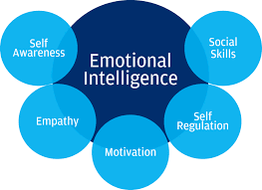
Understanding Emotional Intelligence
Emotional intelligence (EI) is a complex construct comprising five key characteristics that collectively shape an individual's ability to perceive, understand, manage, and utilize emotions effectively in various social and personal contexts. These characteristics are crucial for building and maintaining successful relationships and navigating the complexities of human interactions.
Image Source: Google Images

Slide 20
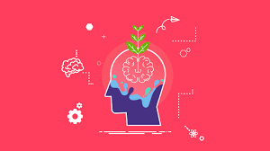
Self Awareness
Definition: Self-awareness is the ability to recognize and understand one's own emotions, thoughts, and behaviours. It involves being in tune with one's moods, strengths, weaknesses, values, and the impact of emotions on decision-making.
Importance: Without self-awareness, it's challenging to regulate emotions or understand their influence on actions and relationships. It forms the foundation of emotional intelligence by allowing individuals to identify areas for growth and improvement.
Image Source: Vantage Fit

Slide 21
Self Regulation
Definition: Self-regulation involves effectively managing and controlling one's own emotions, impulses, and behaviours. It's about being able to think before reacting and exercising restraint in stressful or emotionally charged situations.
Importance: Self-regulation allows individuals to stay composed, make reasoned decisions, and avoid impulsive actions. It fosters adaptability and resilience, enabling individuals to handle challenges with grace and maintain positive relationships.
Image Source: LinkedIn

Slide 22

Motivation
Definition: Motivation refers to the drive and passion to pursue goals with energy and persistence. It involves setting and achieving objectives, both for personal fulfilment and external rewards, even in the face of obstacles.
Importance: Motivation is the force that propels individuals to take action and strive for success. It helps in overcoming setbacks, maintaining enthusiasm, and achieving long-term goals. Motivated individuals are also more likely to inspire and lead others effectively.
Image Source: HR News

Slide 23

Empathy
Definition: Empathy is the ability to understand and share the feelings and perspectives of others. It involves being attuned to the emotions of others and showing compassion and understanding without necessarily agreeing with their viewpoint.
Importance: Empathy is crucial for building strong interpersonal relationships, fostering collaboration, and resolving conflicts. It promotes a supportive and inclusive environment, enhancing communication and mutual respect.
Image Source: Catalyst

Slide 24

Social Skills
Definition: Social skills encompass a range of abilities related to effectively interacting with others. This includes communication, active listening, conflict resolution, negotiation, and relationship-building.
Importance: Proficient social skills enable individuals to navigate social situations adeptly, influence and inspire others positively, and build and maintain meaningful relationships. They are fundamental for success in both personal and professional spheres.
Image Source: Career Addict

Slide 25
Intersection of Self-Management and Emotional Intelligence
Self-management serves as a foundational element for emotional intelligence (EI) by providing the skills and capabilities necessary to understand, regulate, and channel one's emotions effectively.
It's a precursor to developing a high level of emotional intelligence, which involves recognizing and managing emotions in oneself and others.

Slide 26
Emotional Intelligence & Self Management in the Workplace
Self-management and emotional intelligence (EI) are incredibly important in the workplace because they significantly influence an individual's effectiveness, productivity, relationships, and overall well-being within a professional setting.
Enhanced Leadership Skills: Effective leaders need to be able to manage themselves before they can lead others. Self-management and EI provide the foundation for strong leadership by helping leaders regulate their emotions, make informed decisions, and navigate complex interpersonal dynamics.
Effective Communication: Understanding and managing emotions aid in effective communication, allowing individuals to express themselves clearly, listen actively, and comprehend others' perspectives. This skill is crucial for collaboration, conflict resolution, and fostering a positive work environment.
Conflict Resolution and Team Dynamics: Both self-management and EI play key roles in handling conflicts constructively. Employees who can manage their emotions and empathize with others are better equipped to navigate conflicts, find resolutions, and maintain a cohesive and productive team.
Stress Reduction and Well-being: The workplace can be a stressful environment, and self-management skills help individuals cope with stress effectively. EI contributes to stress reduction by promoting resilience, optimism, and the ability to maintain a positive outlook during challenging situations, ultimately improving overall well-being.

Slide 27
Emotional Intelligence & Self Management in the Workplace
Adaptability and Change Management: Modern workplaces are dynamic and subject to rapid changes. Self-management skills foster adaptability, while EI helps individuals manage the emotional impact of change, making them more resilient and open to new ideas and processes.
Customer Relations and Service Excellence: Emotionally intelligent employees can better understand and connect with customers, providing excellent service by responding to their needs and concerns with empathy and patience. Self-management helps in remaining composed and professional during challenging customer interactions.
Decision-making and Problem-solving: Self-management and EI guide decision-making by encouraging thoughtful consideration of emotions and rational analysis. Employees who can manage their emotions are less likely to make impulsive decisions and can approach problem-solving in a logical and strategic manner.

Slide 28
Emotional Intelligence & Self Management in the Workplace
Increased Productivity and Efficiency: Self-management skills, such as time management and prioritization, directly contribute to increased productivity and efficiency in the workplace. When combined with emotional intelligence, employees can maintain focus, minimize distractions, and manage their workload effectively.
Career Advancement and Professional Growth: Individuals who excel in self-management and EI often demonstrate strong leadership potential, teamwork, and adaptability. These attributes can lead to increased opportunities for career advancement and growth within an organization.
Positive Workplace Culture: Self-management and EI foster a positive workplace culture characterized by empathy, understanding, collaboration, and open communication. A positive culture enhances employee morale, engagement, and retention.

Slide 29
Emotional Intelligence and Self Management Videos
Emotional intelligence at work: Why IQ isn’t everything | Big Think
Emotional Intelligence in the Workplace
Emotional Intelligence & Self Management

Slide 30
Learning Objectives Completed
Define Self Management
Importance of Self Management
Key Characteristics of Self Management
Benefits of Self Management
Understanding Emotional Intelligence
The Intersection of Self-Management and Emotional Intelligence
Emotional Intelligence & Self-Management and in the Workplace.
Image Source: Medium.com

